Slide 1

INSIGHTS ON DIVERSITY EVENT
King Lion’s Board Meeting
September 2023
PREPARED BY LAN HOANG
Notes:
Good afternoon everyone,
Thank you for joining me today. I'm excited to present the analysis of the upcoming King Lion's biodiversity event. Our goal is to provide a clear picture of this year event's profitability, logistics, diversity, and key insights that can guide us in making informed decisions. Let's dive right in.

Slide 2
Pre-read
Executive Summary
Financial Overview
Key Insights:
Profitable Regions: Asia Pacific, Greater China, Africa & MENA.
Challenges: Latin America, Europe & Eurasia - negative profit margins.
Opportunity: Optimize Omnivore diet strategy in Latin America
Total Profit: $26,750
Profit Margin: 11.4%
Top Recommendations:
Cost Optimization: Evaluate cost structures and/or reduce participants in unprofitable regions.
Target Growth: Develop targeted growth plans for key profitable regions.
Diversity Consideration: Ensure attendance from under-represented regions (e.g., Latin America, Japan)
Participation Overview
Total: 500
First-time: 98 (20%)
Notes:
To begin, let's take a look at the executive summary.
Financially, the event is poised to be successful with a projected total profit of $26,750, resulting in a healthy profit margin of 11.4%. Furthermore, out of the 500 participants, 98 will be attending for the first time, representing 20% of the total.
Our key insights include the identification of profitable regions such as Asia Pacific, Greater China, and Africa & MENA. However, we've identified challenges in Latin America and Europe & Eurasia due to negative profit margins. The opportunity lies in optimizing cost-effective measures and implementing targeted growth initiatives in Latin America.
Our top recommendations encompass optimizing costs by evaluating cost structures and potentially reducing unprofitable participants in overly represented regions, unless they are strategic partners. We also suggest focusing on growth in key regions and ensuring diversity by inviting participants from under-represented areas such as Latin America and Japan.
an "opportunity" refers to a specific area or situation where there is potential for improvement, growth, or positive change

Slide 3
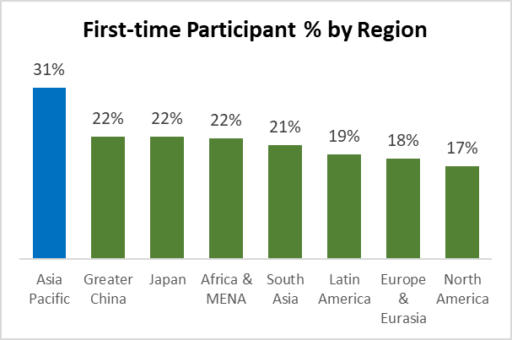
Participant Analysis
This year’s number breakdown and growth rate by Region
98
402
500
Participants
This Year
(20%)
New
Participants
(80%)
Returning
Participants
29%
Europe & Eurasia
32%
North America
9%
Greater China
6%
South Asia
2%
Japan
13%
Africa & MENA
4%
Latin America
6%
Asia Pacific
Greater Asia Pacific – 23%
By geographical region, Latin America is the most under-represented, followed by Africa & MENA
By revenue region, Asia Pacific, Greater China and Japan, despite high YoY participant growth rates, are still under-represented
3
Notes:
Moving on to the participant analysis.
This year's event will see a total of 500 participants, with 98 being new attendees, making up 20% of the total.
By geographic as well as revenue region, we've observed that Latin America has the lowest representation, followed by Africa & MENA.
If looking at geographical regions only, we've grouped South Asia, Greater China, Japan, and Asia Pacific into "Greater Asia Pacific," which now accounts for 23% of the participants.
If looking at revenue regions, interestingly, despite high first time participant rate, Asia Pacific, Greater China, and Japan are still under-represented.

Slide 4
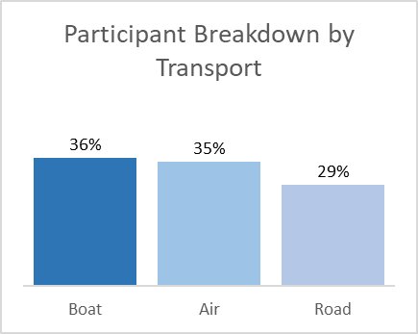
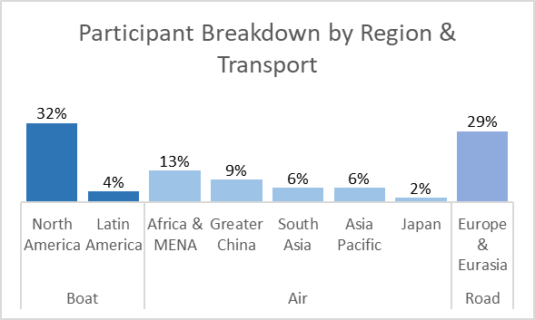
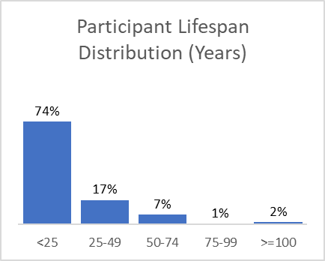
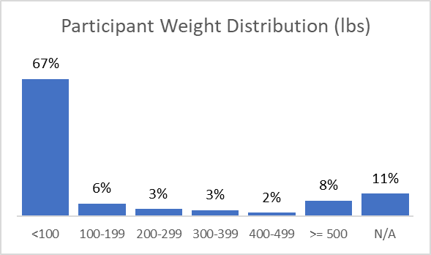
Pre-read
Logistics And Diversity
Travel logistics and more diversity insights
Well-balanced transportation
Air transport is chosen choice for participants from diverse regions
Wide range of lifespan, with most participants (74%) falling under the < 25 years group
Diverse weight groups, with the majority (67%) of participants falling under < 100 lbs category
Notes:
Let's explore travel logistics and diversity insights.
Our travel logistics reveal a balanced distribution with boat, air, and road transport options. Notably, air transport is favored by participants from diverse regions.
Diversity-wise, we've observed a broad range of lifespans, with 74% falling under the < 25 years group. In terms of weight, 67% of participants weigh less than 100 lbs.

Slide 5


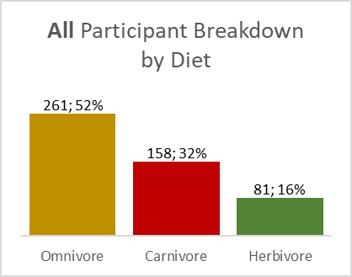
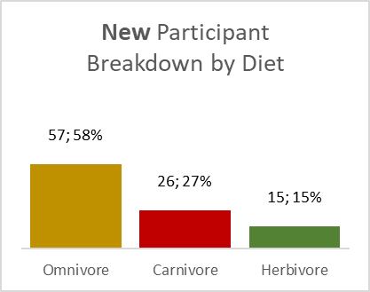
Pre-read
Profitability Analysis I
First glance by Diet
Herbivore and Omnivore diet remain the most profitable.
Event is profitable with a healthy 11.4% profit margin.
Carnivore diet has negative profit margin
Yet, participants with Herbivore diet is still the smallest group and has lowest % of first-time participants this year
→ High growth potential
Notes:
Switching gears, let's discuss profitability by diet.
The event is expected to be profitable, boasting an 11.4% profit margin. Herbivore and Omnivore diets stand out as the most profitable options. Despite the Omnivore diet yielding a higher profit compared to the Herbivore, it's important to note that the higher profit is not the sole indicator of financial efficiency.
The Herbivore diet's higher profit margin suggests it might be more efficient in managing costs and resources, as a larger portion of the revenue is converted into profit, which can contribute to sustained profitability in the long term.
However, it's noteworthy that Herbivore participants are the smallest group and have the lowest percentage of first-time participants. This indicates significant growth potential for this group.

Slide 6
Pre-read
Profitability Analysis II
Deep-dive by Diet and Region
Asia Pacific consistently leads with the highest profit margins across all diet types, followed by Greater China and Africa & MENA,
Herbivore diet maintains high profit margins in most regions, indicating efficient cost management.
Participants with Carnivore diet from Europe & Eurasia and North America remain unprofitable due to high diet costs,
Latin America and Japan, due to overall low per-participant revenue, incurs overall negative profit margins.
Notes:
Digging deeper into profitability, let's look at diet and region-specific insights.
Asia Pacific consistently leads with the highest profit margins across all diet types, closely followed by Greater China and Africa & MENA. Herbivore diets show efficient cost management across most regions, maintaining high profit margins.
However, participants with a Carnivore diet from Europe & Eurasia and North America face challenges due to higher diet costs. Additionally, both Latin America and Japan experience overall negative profit margins due to lower per-participant revenue.

Slide 7



Recommendations
For next year’s event
Growth Opportunities:
Develop targeted growth strategy for Asia Pacific, Africa & MENA and Greater China participants
Increase attendance of Herbivore participants + sustain growth of Omnivore participants
Optimize costs
Balance out regional and diet over-representation
Contribute to overall financial performance
Boost representation from under-represented regions
Cost-saving Opportunities:
Cost review and/or reduce attendance of Carnivore participants from North America, Europe & Eurasia
Reduce cost and support profitability goal
Boost diet diversity
Diversity Consideration:
Essential to include participants from under-represented Latin America, and Japan (depending on diversity criteria)
Ensuring geographical diversity
7
7
Notes:
I would now like to conclude with our recommendations for next year's event.
We see growth opportunities in Asia Pacific, Africa & MENA, and Greater China. Doing so would help optimize costs and addressing regional over-representation,.
Boosting the presence of Herbivore participants and sustaining growth among Omnivore participants will contribute to this goal, while also enhancing financial performance
Cost-saving measures include reviewing costs and potentially reducing Carnivore participants from North America and Europe & Eurasia, aligning with our profitability objectives while promoting diet diversity
Lastly, ensuring diversity representation from under-represented regions like Latin America and Japan are crucial for geographical diversity.
Thank you for your time, and I'm open to any questions you may have.

Slide 8
Appendix I
Lifespan Group and Weight Group by Diet
Many participants in the Carnivore and Omnivore diets falling into the <25 years of lifespan and <100 lbs weight group.
No straightforward pattern indicating that a specific diet is inherently linked to a particular lifespan or weight category.

Slide 9
Appendix II
Deep-dive by Diet and Region with Revenue and Cost

